Slide 1


Virtualization Unleashed: Building Labs on Your Laptop / Desktop
Kalesha Gagguturu
Notes:
Hello there! Greetings of the day and welcome to Kalesha's TechFusion channel! In this video we’ll see some brief introduction to virtualization and then we will follow with hands-on of how to create lab environments right on our laptops or desktops. And let us continue further without ant delay.

Slide 2



Agenda
Hypervisors
Virtualization
lab environments configuration
Notes:
For now, let us see some brief introduction of virtualization and Hypervisors and then we will follow setting up labs with different virtualization tools.

Slide 3
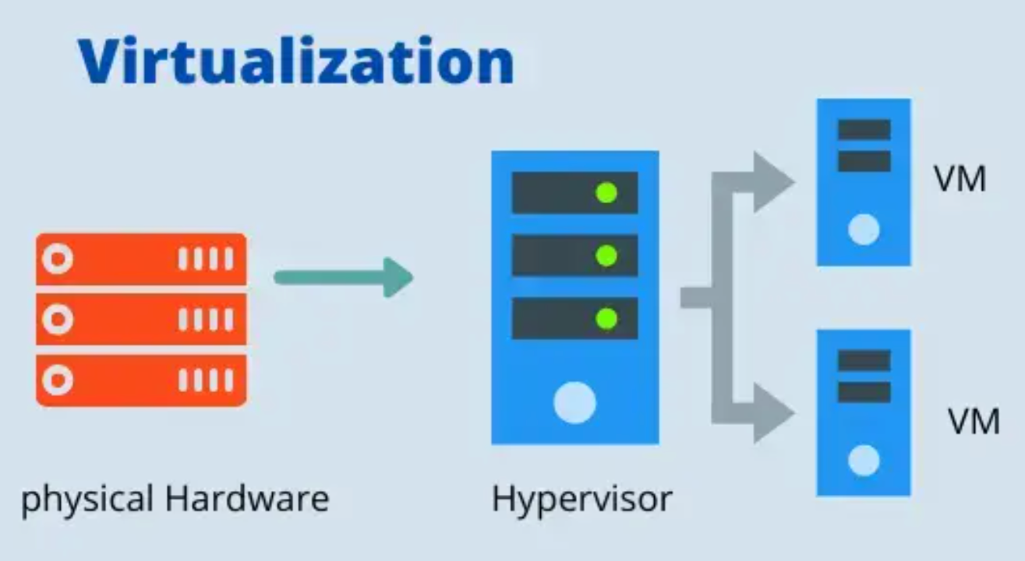


Introduction
Virtualization allows us to
Create multiple virtual instances.
This technology is incredibly useful for
Testing
Development
Training and
Running multiple os without the need for separate hardware.
Wednesday, August 23, 2023
Kalesha Gagguturu
Notes:
Before we dive into setting up labs using virtualization tools, let's understand the basic concept behind virtualization and why it's essential for IT professionals.
First of all, What is Virtualization? So being as IT Professional we mostly hear about Virtualization on many occasions.
Basically, in common terms virtualization is the creation of a virtual -- rather than actual version of something, such as an operating system (OS), a server, a storage device or network resources.
So, what is hypervisor and is it same as virtualization? Hypervisor and virtualization are closely related terms, but they refer to different aspects of the virtualization technology.
Virtualization is the broad concept of creating virtual instances, while a hypervisor is the software that manages and facilitates the creation and operation of those virtual instances on a physical machine.

Slide 4
Key Benefits
Resource Efficiency
Isolation and Security
Snapshot and Restore
Easy Replication
Economical
Wednesday, August 23, 2023
Kalesha Gagguturu
Notes:
Resource Efficiency: Instead of dedicating separate physical machines for each task, virtualization enables us to use the same hardware for various purposes, optimizing resource utilization.
Isolation and Security: Virtual machines (VMs) are isolated from each other, providing a secure environment for testing and experimentation without affecting the host system.
Snapshot and Restore: Virtualization tools allow us to take snapshots of VMs at different points, providing a safety net for experimenting, as we can revert to a previous state if something goes wrong.
Easy Replication: Creating multiple identical VMs is effortless, making it easier to set up complex network configurations or test different scenarios.
Economical: Virtualization reduces the need for physical hardware, which can be cost-effective, especially for personal labs or small-scale testing environments.

Slide 5

Summary
That is just basic introduction which is sufficient for setting up the lab environments on our devices.
Wednesday, August 23, 2023
Kalesha Gagguturu
Notes:
Now that we understand the benefits and we have multiple Virtualization tools to setup our labs on our devices something like KVM, Hyper-V, VMWARE workstation and Oracle Virtual Box etc….
But for now, we will see how to setup labs using Microsoft Hyper-V, Oracle VirtualBox, and Vmware Workstation on our devices.
Here Oracle Virtual box is free to use without license and Vmware workstation is licensed version and Microsoft Hyper-V is available on Pro or Enterprise versions of Microsoft windows and mostly introduced with Windows 10 onwards.
That’s all for now and we will continue our session to setup our lab using these virtualization tools.

Slide 6


Thank You
Kalesha Gagguturu
gagguturu.kalesha@gmail.com
@KaleshaTechFusion
Wednesday, August 23, 2023
Kalesha Gagguturu
Notes:
I hope this video is informative and if you have any queries, please do let me know in the comment section. If you like this video, please like and share. Also please support me by subscribing my channel.

